Slide 1
A Crash Course in LaTeX
E96: Python and Machine Learning
Notes:
Joey

Slide 2

What is LaTeX?
Typesetting Language
Used to generate professional documents
Commonly used for scientific documents, books, lab reports, CV’s and more

Slide 3
Why Use LaTeX?
Makes Homework’s and lab reports look very nice.
Gives far more flexibility and control over the document layout unlike typical word processing software
Makes inputting equations, generating tables, updating tables of contents, generating bibliographies, and maintaining a consistent layout extremely easy.
Notes:
Enoch

Slide 4
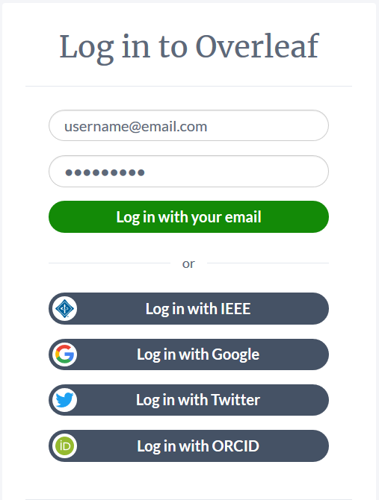
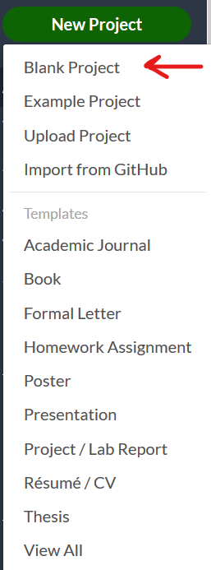
Overleaf
Online LaTeX editor
Allows for syncing with Github
Provides many free templates
Register and login at https://www.overleaf.com
Click on the New Project button and select a new Blank Project
Notes:
Enoch

Slide 5
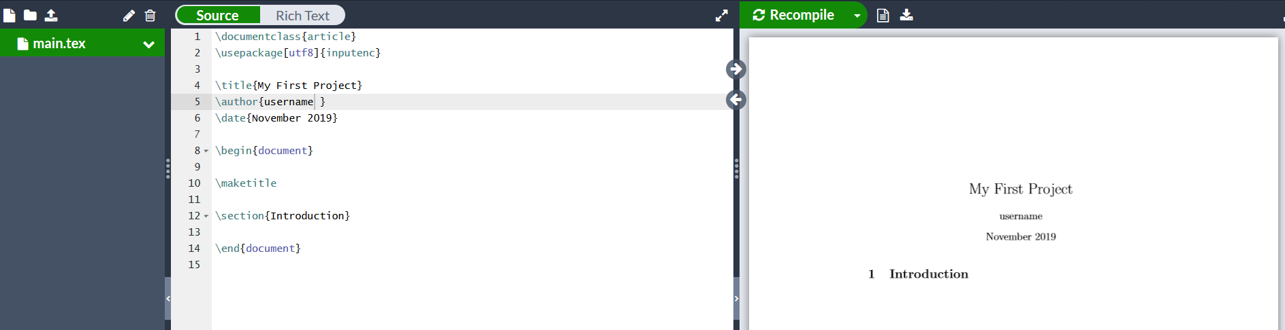
Overleaf
On the left will be the code editor. Set to Source to type in the code by hand.
Once Recompile is clicked, all code on the left will generate the pdf on the right.
If Rich Text is selected a more Microsoft Word esque editor will be displayed on the left.
Notes:
Enoch

Slide 6
DocumentClass
\documentclass[font size, paper size]{argument} is required to tell the compiler how to layout the document.
Base LaTeX offers 4 types of documentclass files: article, book, report and letter.
Various paper sizes can be provided as well such as letterpaper, a4paper, legalpaper and more
More classes and paper sizes can also be downloaded from the internet
Notes:
Enoch

Slide 7
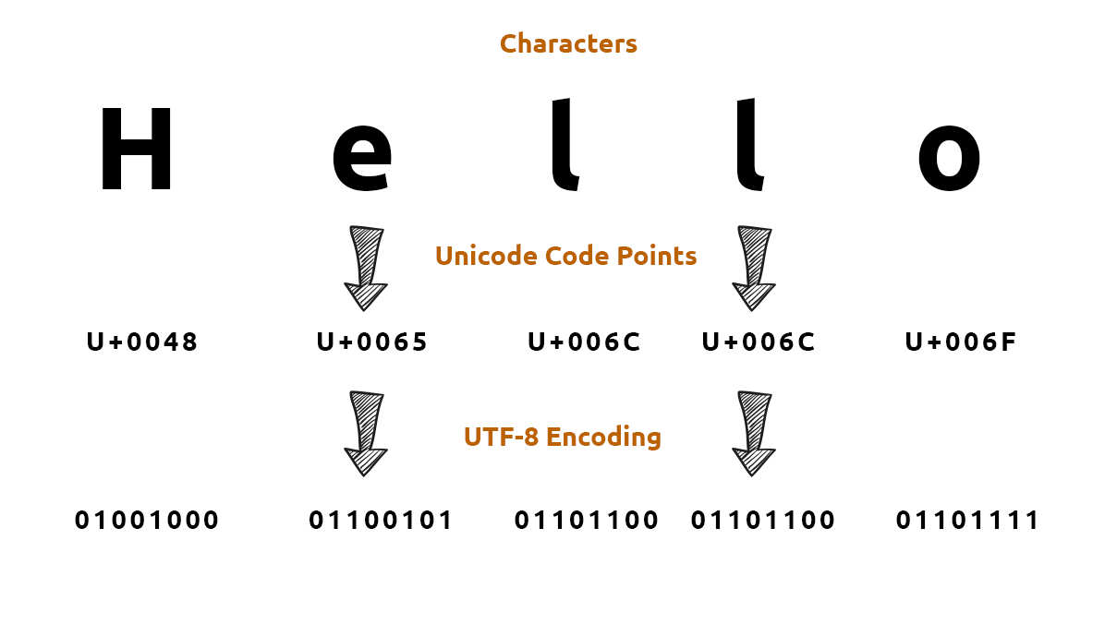
Character Encoding
Tells the compiler how to encode characters into bits.
\usepackage[utf8]{inputenc} will use whatever input encoding it receives and encode it as utf-8.
If you have no need for a specific character encoding just use utf8 or unicode.
Notes:
Enoch

Slide 8


Making the Title
\title{} is used to generate the name for the title of the document
\author{} will place the text centered below the title.
\date{} will place the text provided below the name. \today will give the current month day and year.
Notes:
Enoch

Slide 9

Beginning the Document
Now that the boilerplate is out of the way, LaTeX likes to use environments that start with begin{} and end with end{}.
The keyword “document” will start an environment corresponding to the document. All text placed in here will be displayed on the document on the right.
\maketitle will generate the title set up on the last slide.

Slide 10
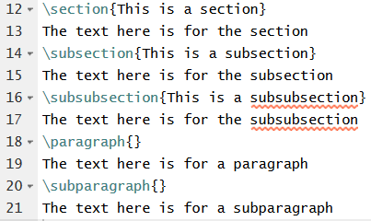
Sections, Subsections and More
\section{} will generate a new numbered section with the name provided in the curly braces.
\subsection{} and \subsubsection{} will generate sections within sections numbered as section number, subsection number, subsubsection number.
\paragraph{} and \subparagraph{} can be used to generate tabbed and double tabbed sections of text within a section
No need for begin and end blocks. A section ends at the start of a new section or end of document

Slide 11

Sections, Subsections and More
\section{} will generate a new numbered section with the name provided in the curly braces.
\subsection{} and \subsubsection{} will generate sections within sections numbered as section number, subsection number, subsubsection number.
\paragraph{} and \subparagraph{} can be used to generate tabbed and double tabbed sections of text within a section
No need for begin and end blocks. A section ends at the start of a new section or end of document

Slide 12


Commenting the Code
Comments are helpful to make notes to your future self, section your code and mark important details you don’t want printed on the document.
They are made using the % symbol. This raises an issue when you need a % in the text. To get around this, \% is used to display the % character.

Slide 13
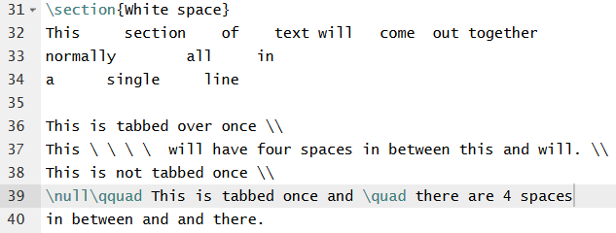
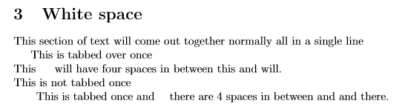
White Space
The LaTeX compiler will ignore all whitespace in the code except for one space in between words. This includes multiple spaces, tabs, and newlines.
To cause text to start a new line use \\ or \newline. You can also hit enter twice, but it will tab over the text.
LaTeX deletes all white space at the beginning of a line. To get around this add \null\quad for a tab. \quad \qquad and a \ followed by a space give 4 spaces, 8 spaces and 1 space.

Slide 14
Miscellaneous Helpful Commands
\textbackslash can be used to generate the \ character.
\pagebreak can be used to end a page early and place all text onto the next page
The pipe character | will create a long dash. \vert can be used to generate the pipe character |.
The ~ character can be used to generate a space. To place this character in use \sim.
Sections can be created with {} that will group text together. Useful if using \tiny, \small, \normalsize, \large, \Large, \LARGE, \huge, or \Huge to change font size mid sentence.
\noindent can be used to remove the automatic indent after two enters pressed.

Slide 15
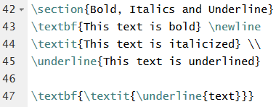
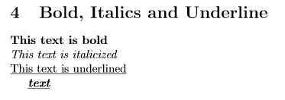
Bold, Italics and Underlying
\textbf{} will create bold text
\textit{} will create italicized text
\underline{} will underline text
They can be stacked for combined results i.e. \textbf{\textit{\underline{text}}}

Slide 16
Challenge #1 (5 minutes)
Write a document with three sections. The first section should be titled “Subsection Test”. In it create 2 subsections and in each subsection create a sub sub section. Give each a creative name and write some text in each subsection and subsubsection to see how the text displays.
The second section should be titled “White Space” and in it there should be 3 lines of text. The first line should say “There are four spaces in between four and spaces.” The second line should say “There is no indent here, I’m 100% sure of it.” The third line should have an indent and say “ There is an indent here.”
The third section should be titled “Bold, Italics and Underlines”. Write two lines in here with no indents. First line should say “This is bold, italicized and underlined.” Second line should say “This is bold, italicized and underlined”

Slide 17
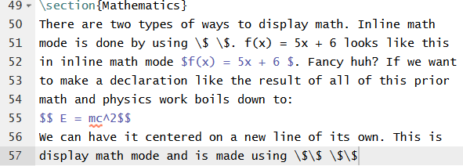
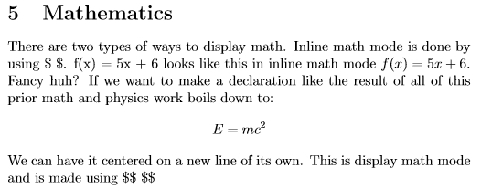
Equation Editing
Latex has two types of modes for generating math equations. Inline math mode and display mode.
Inline math mode uses $ $ and displays the math in the same line as the text surrounding it. $f(x) = 2x + 5$. Will display the math in the text itself. To get $ in text by itself use \$.
Display math mode uses $$ $$ and displays centered on a new line.
Notes:
Enoch

Slide 18
Useful Math Inputs
Greek letters are written as \ followed by their names. Lowercase sigma would be \sigma and uppercase sigma would be \Sigma.
\frac{num}{den} will create a fraction with the input in num on the numerator and den in the denominator.
\sqrt{} is for square roots and \vec{} is used to add an arrow over the input, \hat{} adds a ^ over the input.
To create a subscript use _{subscript text} and to create a superscript use ^{superscript text}.
\int generates an integral, \iint creates a double integral, \iiint creates a triple integral, \partial creates ∂, \nabla creates ∇, \circ creates °, and \sin, \cos, \log can be used for their respective functions.
All of these can only be used in math mode so if you want greek letters or math in the middle of your text use inline math mode.
Notes:
Enoch

Slide 19

Useful Math Inputs
If there is an equation you can write on a piece of paper by hand that would seem impossible to write using MS Word or Google Docs, LaTeX makes it very simple.
Additional math libraries add in other useful equation components like \iint for a double integral or \oiiint for a triple surface integral. Typical math packages can be added with \usepackage{} at the top of the file. esmath and amsmath are two common packages used.
Notes:
Enoch

Slide 20
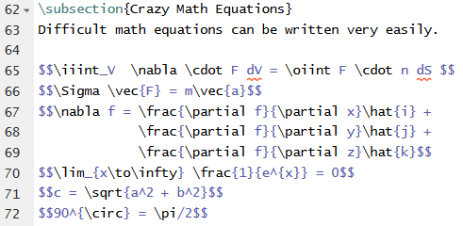
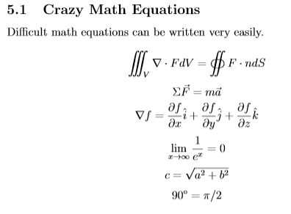
Useful Math Inputs Code and Output
Notes:
Enoch

Slide 21
Challenge #2 (5 minutes)
Make a new section names “Math Equations” and inside it write the following text. “If I had $5 and I spent $3 I can find the result as $5 - $3 = $2.” Now make a new line and write the following text, “If I was writing this document in Word, it would take forever to write Faraday’s Law in integral and derivative form. In LaTeX its as simple as:” Now write using display math mode both forms of Faraday’s law from the picture below. (Hint: \cdot can be used for dot product, \times can be used for cross product and \oint gives a surface integral. The upside down triangle is called nabla and the greek letter is called sigma.)
Notes:
Enoch

Slide 22
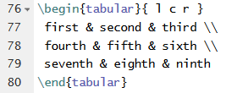

Tables
To begin a new table use \begin{tabular}{columns}. Inside of columns will go r, c, or l followed by spaces. Every letter will correspond to a new set of columns. l will align all items left in that column, r will align right and c will center them in the middle.
& will separate items in each row and new rows can be generated with a newline \\ or \newline.

Slide 23
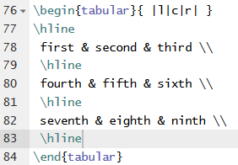

Tables With Borders
The \hline command will generate a horizontal line that will cover an entire row. Using the pipe character | in the column argument list will generate a vertical line spanning the whole box.
Columns can be annoying to generate sometimes, so if there is a need for a complicated table https://www.tablesgenerator.com/ is a good resource for easily generating LaTeX code for tables.

Slide 24
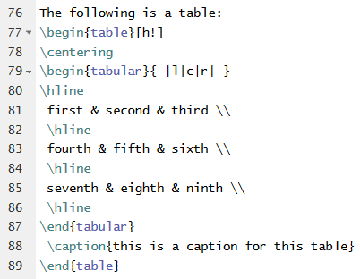
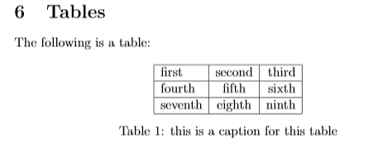
Tables with Captions
Adding a caption under a table can be done surrounding the tabular with \begin{table}[h!] and \end{table} environment.
\centering will center the whole object.
\caption{caption text here} will generate a caption under the table. It will label the table number based on how many previous tables you’ve used. Make sure to place it after the tabular environment

Slide 25
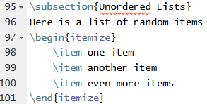
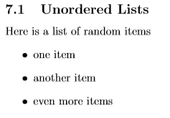
Unordered Lists
Unordered lists are simply bulleted lists with no particular order.
To start a new unordered list environment, use \begin{itemize} and \end{itemize}
Use \item to generate a new bullet point for the list.

Slide 26
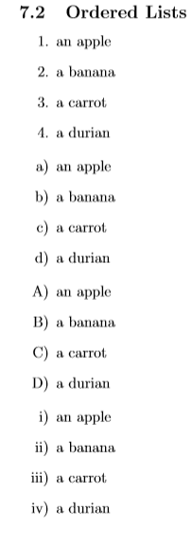
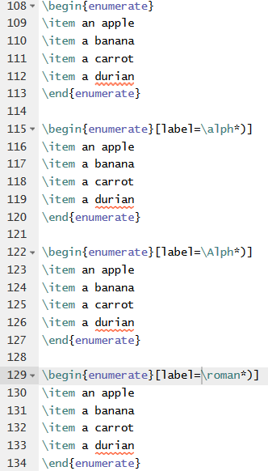
Ordered Lists
Ordered lists label each of the \item tags in order. Adding \usepackage{enumitem} to the top of the document enables lists other than numerical.
A numerically ordered list environment can be started with \begin{enumerate}. Lowercase lettered lists can be made with \begin{enumerate}[label=\alph*], Uppercase letter lists with \begin{enumerate}[label=\Alph*] and roman numeral lists with \begin{enumerate}[label=\roman*]

Slide 27

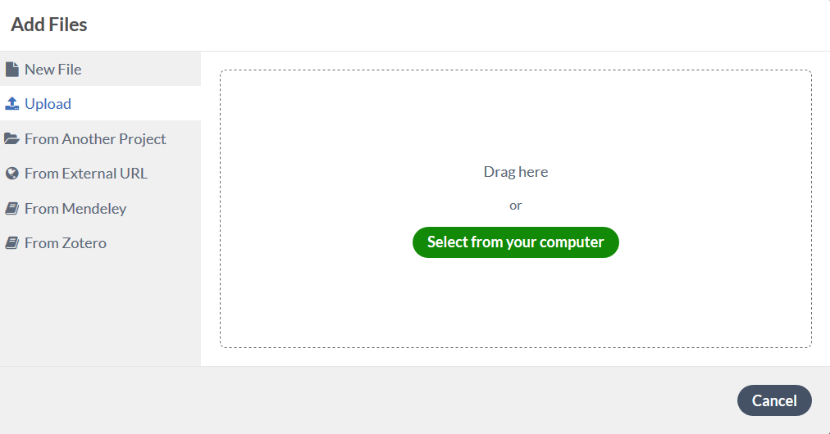
Images
To insert images into your file you will need to add a new package to you file \usepackage{graphicx}.
To upload images to overleaf, click on the upload icon in the top left corner of the editor window.
Select the image you want to upload and it should appear in the file bar on the left.

Slide 28
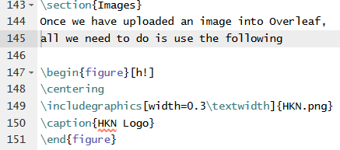

Images
We can create a floating environment like we did with the table. This time we use \begin{figure}[h!] with \end{figure}.
\includegraphics[modifiers]{filename} can be used to generate the image itself. In this case HKN.png was the filename and the width was set to 0.3\textwidth. Values can also be specified in cm, mm, in, ems and more.
We can center and add captions as seen before as well. LaTeX will automatically number all figures in the order they appear.

Slide 29
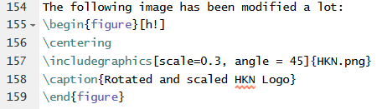
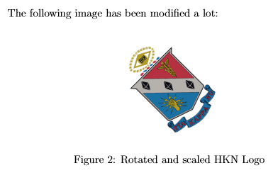
Modified Images
Width isn’t the only thing modifiable. scale=scalefactor can be used to scale width and height. height=heightval can be used to set the image height. angle=rotation_angle can be used to rotate the image.
An example of this can be seen on the right.

Slide 30
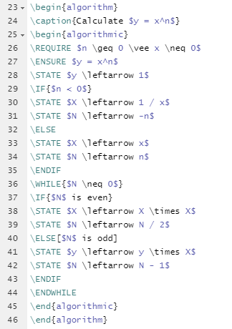
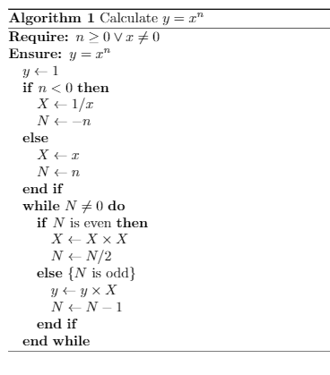

Algorithm and Pseudocode
We can also write your own algorithm and pseudocode and format them nicely in LaTex.
Includes the algorithm package and build your own algorithm!
An example of this can be seen on the right.
Notes:
Enoch

Slide 31
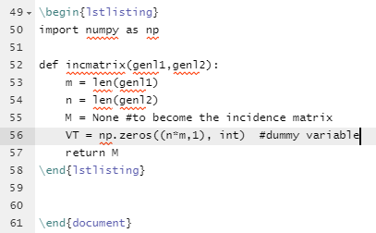
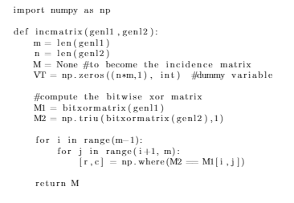
List Code
We can demonstrate your code in LaTex by using listings package.
An example of this can be seen on the right.
Notes:
Enoch

